Slide 1




Case studies of best PB practices
Julia Slav
Council of Municipalities of St. Petersburg
Presenter: Jaroslav Dvorak
Klaipeda University, Lithuania
Date 18.10.2021

Slide 2
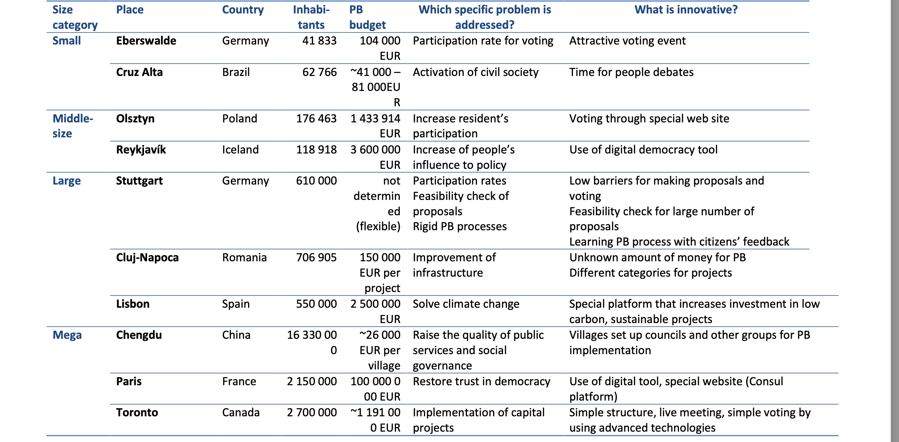


Table of cases

Slide 3
Eberswalde, Germany (small)
population 41 833 people
PB history. Established in 2008 based on initiatives by the local council as one of the first PB processes in Germany. Annual PB process, since 2012 as citizen budget.
Regulations. Citizen budget: direct democratic. Through a PB statute, a specific budget is set aside for direct implementation of the highest voted proposals.
PB budget. 104 000 EUR. PB budget per inhabitant: 2,49 EUR.
PB process. 3 stages: proposals (1), feasibility check (2) and voting (3) .
Success in 2020. Number of proposals: 103. Number of voters: 2.073 (+12%). Participation rate of eligible voters: 5%.
PB case highlights
Voting takes place on one day only, usually one Saturday in September of each year. Event lasts 9 hours, supported by around 30 voluntary staff members of the city administration.
Organized in the city’s “family garden” containing a playground for children and other recreational facilities.
Special voting day was created to attract female citizens and families to participate in voting. In 2020, the number of participants increased by 12%, and the proportion of women was 53%.
Links
https://www.eberswalde.de/fileadmin/bereich-eberswalde/global/Buergerbudget/Evaluation_Eberswalder_Buergerbudget_-_Fortschreibung__Februar_2020_.pdf

Slide 4
Cruz Alta, Brazil (small)
population 59 922 thousands people
PB history. Began in 2004 when the Workers' Party (Partido dos Trabalhadores) won the election. Since that the PB process continues in Alta Cruz, whereas the latest editions have been approved for the 2017-2020 reporting years.
Regulations. A city law legitimized the creation of the Coordenadoria de Relações Comunitárias and appointed city committee on PB.
PB budget. Is not fixed for a special year and depends on the communities’ chosen projects.
Process. Different ways of involving the residents. Regional Preparatory Meeting, which is open to the public and attended by community leaders. The Regional Assembly is open to the public and attracts the same participants as a Regional Preparatory Meeting.
Success. By 2006, only 60% of urban districts had residents’ associations, but in 2009, there were already 90%.
PB case highlights
One of the major successes of the PB process was the reactivation of civil society. In 2004 only half of the resident associations were active offering organized activities and recurrent meetings in the neighborhoods. After 4 years of PB 100% were active because to be effective in PB is required to be active.
Links
https://participedia.net/case/2438

Slide 5
Olsztyn, Poland ( middle size)
Population 176 463 people
PB history. PB or Civic Budget (CB) is a long‐term process with annual cycles. First PB in 2014 with 0,23 % of total budget.
Regulations. Municipal Local Government Act of 31 January, 2018 recognizing PB as a special form of social consultations. PB is mandatory in local governments with county rights. The entry ticket is the Resolution of self-government council.
PB budget. 104 000 EUR realised In 2020 and 1 433 914 EUR planned for 2021. PB budget planned per inhabitant: about 8 EUR in 2021.
PB process. Six stages: (1) submission process, (2) evaluation of applications, (3) appeal of the evaluation of applications, (4) announcement of the list of projects for voting, (5) voting, (6) official announcement of the results. Citizens over 15 years old are allowed to participate.
Sucsess. For its 7th edition, Olsztyn’s PB tripled in comparison to the 1st edition, and collected 216 182 votes to choose nearly 900 projects. According to the survey held in 2017, about 90% of the respondents plan to participate in the next editions.
PB case highlights
Introduction of PB in Polish cities has contributed to increasing the activity of residents in relation to local government and local issues, changing their often socially passive attitude into an active one.
Voting via the e-puap i.e., a website allows voting papers to be sent to the office without the need to visit the office.
Links https://glosujobo.olsztyn.eu/wszystko-o-budzecie

Slide 6
Reykjavík, Iceland ( middle size)
Population 118 918 people
PB history. The “Better Reykjavík” website was launched in 2010 by two private citizens. Collaboration of the city Council with the “Better initiative” which became “My Neighbourhoods” forum, that is the annual PB since 2011 .
Regulations. The “Better Reykjavik” platform is managed by the non-profit organization. Participation in the “My Neighbourhood” final vote is more restrictive, requiring users to obtain verification by the Icelandic National Voter Registry.
PB budget. A yearly allocation of 3,6 million EUR to PB initiative ensables the public to spend approximately 5 - 6% of the city's capital investment budget. PB budget per inhabitant: 30 EUR.
Process. Citizen Foundation writes the softwear- of Reykjavík runs the election - the National Registry authenticates voters.
Success. More than half (70 000) of the city’s population (120 000) have participated in 2018. While there were 40% in the first year (2011).
PB case highlights
“Better Reykjavík” is an umbrella for many different projects. The initiative is named as digital democracy.
Integration with social media allows for easier diffusion of ideas and helps promote «Better Reykjavík».
The most successful innovation is the high-level debate system.
Links
https://openpolicy.blog.gov.uk/2014/10/15/better-reykjavik/

Slide 7
Stuttgart, Germany ( large)
population 610 thousands people
PB history. Established in 2011 through initiative by one citizen. Bi-annual PB process, in 6th edition in 2021.
Regulations. Consultative only, PB statute defines steps of the PB process and is adjusted for every PB edition → “Learning” PB process.
PB budget. Total amount of money spent in last process: not determined, flexible. PB budget per inhabitant: not determined, flexible.
Process. Three phases: (1) proposals, (2) voting (“likes” and “dislikes” are possible, but “dislikes” ore not deducted from “likes”), and (3) feasibility check for ca. 100 best-voted projects
Success. In 2020 number of proposals: 2.156. Number of voters: 19.980 (-50%) with 1.306.395 votes. Participation rate of eligible voters: 3,3%
PB case highlights
High participation rates through easy access (no age limit for making proposals and voting; all residents can participate; proposals at any topics, no cost estimation required, voting online, offline or through signature lists possible)
Links: https://www.buergerhaushalt-stuttgart.de/seite/14439
https://www.eberswalde.de/start/stadt/eberswalde-auf-einen-blick

Slide 8
Cluj-Napoca, Romania (large)
population 706905 thousands people
PB history. Idea of a participatory budget was first proposed in Cluj-Napoca during the 2002 election campaign. In 2013, a pilot project for a participatory budget was implemented in the largest district of the city (Mănăștur).
Regulations. No legislation basis for an initiative for citizen participation.
PB budget. The maximum amount per project was 150 000 EUR.
Process. Oganized by identifying categories into which residents can submit projects. The city council checks eligibility of the projects. Residents vote for approved projects (in one or more stages).
Success. The total budget in 2013 was 4,3 million EUR, or 0,75% of the city's municipal GDP. In 2015, the Youth Participatory Budget was implemented as part of the European Youth Capital program. 437 initiatives, of which 117 received funding. 100 small projects initiated by young people were funded.
PB case highlights
Separate from the ordinary PB, the Youth Participatory Budget was set up in 2015 as part of the European Youth Capital program. The initiative was implemented within the framework of a project initiated by a local NGO. The main sponsor of the project was the European Economic Area Grants. increased the participation of young people.
Links: https://participedia.net/case/5556

Slide 9
Lisbon, Portugal (large)
population 550 thousands people
PB history. The first European country that invested public funds in PB. First adopted by city council in 2008. Operates in an annual cycle with the democratic voting by every resident over 18.
Regulations. The Law No42/2016 which set up legal rules for PB, ”Charter of principles” – the road map for PB, Specific administrative division – Division for Organizational Innovation and Participation.
PB budget. 5 million EUR (5,4% of Lisbon city ́s annual budget) in the first year, later reduced by half. PB budget per inhabitant: about 1,18 EUR.
Process. Portal Lisboa Participa (https://op.lisboaparticipa.pt/home) -municipal space for PB. On–line and face-to face participation. Since 2013, citizens can vote through SMS.
Success. More than 1 730 participants voted in 2008. From 2008 to 2018 6 743 proposals submitted, 2 079 of them were selected and a total of 36, 310 688 EUR have been allocated to 139 projects.
PB case highlights
First 'green’ PB , 5 million EUR budget to support climate change mitigation and adaptation projects selected by local citizens.
Integration of diverse social groups, usually excluded from public participation PB
Links
https://www.lisboaparticipa.pt/
https://participedia.net/case/4967
https://op.lisboaparticipa.pt/home

Slide 10
Chengdu, China (mega)
population about 16 million people
PB history. PB focused on ensuring spatial justice and reducing rural-urban development disparities.
Regulations. The regulation by the Chengdu Communist Party Committee and the municipality, PB divided into 4 main categories.
PB budget. 26 056 EUR per village.
Process. 3 steps cycle. (1) information is collected on what projects are needed. (2) decision-making in rural council. (3) project monitoring and evaluation.
Success. The total annual PB budget has first doubled and then tripled. 17,91 EUR/capita per year.
PB case highlights
Under the participatory budget initiative, each village has set up a village council with 20 members
A special budget monitoring group (5 to 7 elected rural residents) was set up to monitor and supervise the PB that increased citizens control
Links
https://participedia.net/case/5969

Slide 11
Paris, France (mega)
population 2,15 million people
PB history. Established in 2014 as a pilot project. Annual since 2015, with the allocation of 5% of the city’s investment budget each year.
Regulations. Charter of Participative Budget, adopted by authorities. Elected Committee that evaluates projects proposed by the residents.
PB budget. Since 2016 100 million EUR is allocated annually. PB budget per inhabitant: 45 EUR.
Process. 4 steps cycle. (1) proposals. (2) co-creation (3) selection of projects by the elected Committee. (4) voting and including selected projects in the budget.
Success. (1) competitive leadership; (2) properly selected instruments for the implementation; (3) aid for the residents willing to participate; (4) diversification of the PB itself; (5) commitment to the PB.
PB case highlights
“Law on Local Democracy” gave citizens the right to petition, and mechanisms were created for all levels of government to create referenda and hold public consultations.
For the purpose of citizens’ participation several institutions were established : Neighbourhood councils, Youth council, Parisian students council etc.
New digital tools (the so-called ‘civic tech’) were introduced
Links
https://participedia.net/case/5008
https://budgetparticipatif.paris.fr/bp/plugins/download/PB_in_Paris.pdf

Slide 12
Toronto, Canada (mega)
population 2, 95 million people
PB history. Toronto piloted the PB 2015-2017 in three wards. The final evaluation of the PB Pilot was approved by the City council in 2019.
Regulations. The City council decision is needed to initiate the PB pilot.
PB budget. Over the three-year pilot, residents voted for 37 projects and the total amount of 1,19 million EUR was allocated.
Process. 6 steps cycle. (1) idea collection (2) idea review (3) ballot selection
(4) voting. (5) ballot allocation. (6) implementation
Success. lies in the thoroughness of the pilot. PB pilot provided for the information about the usefulness of such an instrument of engagement.
PB case highlights
a good example for small communities in megacities how to introduce the PB
constant involvement of the City Staff in PB
simple structure that could be a useful strategy in communities with poor IT development or great share of elderly population.
Links
https://www.toronto.ca/city-government/budget-finances/city-budget/

Slide 13
Julia Slav
Council of municipalities of SPB
juliaslav@mail.ru
PP15-PP16-PP17
EmPaci

