Slide 1
2. PB Cycle
Steps toward PB in Municipali​ties
How to get started?
[Experiences from Finland]
PP18 TAMPERE UNIVERSITY
PP19 LAB UNIVERSITY OF APPLIED SCIENCES
13 October 2020

Slide 2
PB Pilot Process
Resources, funding, themes, defining, rules, tools
How, when, where, with whom?
Improving PB
Want/
Need
Process
Political Decision
Imple-mentatio
Feed- back
Develop-ment
Reasoning behind running a pilot
Support for process
Gathering data

Slide 3
PB in Finland 2020
PB is very “In” in Finland at the moment: there are implementations running in large cities, small towns and everything in between such as Helsinki, Tampere, Turku, Vantaa, Oulu, Tuusula, Nurmijärvi, Hyvinkää, Kangasala, Loppi, Hämeenlinna, Inari, Janakkala and EmPaci pilots Lahti and Riihimäki
Budgets range from a few thousand EUR to 8,8 MEUR pledged by the capital city Helsinki for every other year
Budget for Lahti and Riihimäki was 100 000 € each

Slide 4
Choosing a Theme for PB
Examples of PB Themes:
  No special theme: Citizens can freely propose ideas. However budget, legislation and municipality's authority may set limits to proposals.
  Special theme or themes: There is special theme (s) for PB (e.g. environmental or cultural issues). Proposals have to fit into this theme. Budget, legislation and municipality's authority may set limits to proposals.
  Prepared proposals: Municipality gives loose proposals from which citizens can choose.
  Special target group(s): PB is indicated to issues that concern certain citizen groups (e.g. chidren, old people, disabled).
  Special region/city district: PB is focused to certain city district.
  The budget defines, which of these options (if any) is suitable for the municipality. If the budget or other resources are small, some framing is sensible. Or if the aim is to pay attentioon to special socio-economical issues or some hard-to-reach groups, it is sensible to frame the target group or for example the city district.
  Choosing the theme carefully is important, because it influences on the amount of proposals and the voting turnout. One option is to discuss about the themes with the citizens before decide anything. The themes can be co-created.

Slide 5

Pilot 1. Lahti

Slide 6
Backround on “Why to try PB in Lahti”?
To follow statute of the law (Municipal Act in Finland)
To strengthen the well-being of inhabitants (citizen as an active actor, not a passive service-user)
To build more open, transparent and participatory culture in municipal organizations
To create new ideas
To build new connections to inhabitants
To strengthen the understanding of inhabitants on how and why municipal funds are spent
To find solutions to things the questions/themes of PB
To change the way projects are done in Lahti
To do something fun with inhabitants and stakeholders
To find new places for making savings together with inhabitants
Source: Presentation at seminar September 2019, Tia Mäkinen from Association of Finnish Municipalities and Karreinen, L.

Slide 7
Example of Local PB Rules
OmaLahti, Lahti
Ideas/proposals must:
Be made in accordance with rules, regulations and the law
Fall under city jurisdiction
Be in line with the give themes
Be implemented with the max. amount of funds allocated for set PB/Area/Theme. (Can also be considered as partial funding for a larger project)
Not have long-term financial impacts for the city (no permanent staff, large maintenance costs)
Be non-commercial
Be non-discriminatory and promote equality
Be possible to be implemented by the City in 2020 - 2021
Source: https://www.lahti.fi/paatoksenteko/osallistujavaikuta/osallistuva-budjetointi

Slide 8
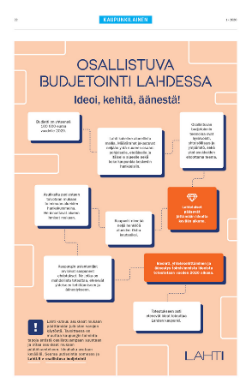
2.Finnish Examples:
Lahti PB Pilot 2020, steps
Lahti PB-team= 2,5 people supported by communications and other division on a need-basis. An internal steering group
Idea creation by inhabitants (spring)
  Four themes, three from City (wellbeing, community and environment ) and one (Sports) from inhabitants
  Four areas – Northern, Southern and Eastern as well as entire city, 25 000 € each
Pre-Check by City (summer)
Co-Creation by City and inhabitants (summer/fall)
  At a special co-creation Lackathon event arranged 13.8.2020 at Palvelutori -service point
Voting open to all inhabitants (fall)
  3896 inhabitants voted, and 10 ideas were chosen for implementation.
Implementation by the City (fall--- 2021)
Specialty:
Project Guardians – volunteer inhabitants supporting the pilot externally in their areas
PB Coaches -chosen individuals from the City organization supporting the pilot internally within the city divisions
Libraries supported process
No specific PB-platform in place – existing programs used to run pilot
Picture: The City of Lahti
Source: https://www.lahti.fi/paatoksenteko/osallistujavaikuta/osallistuva-budjetointi & Tia Mäkinen and Sanna Virta, PB Team at the City of Lahti

Slide 9
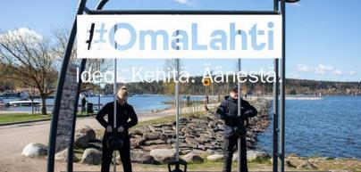
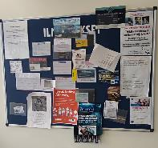
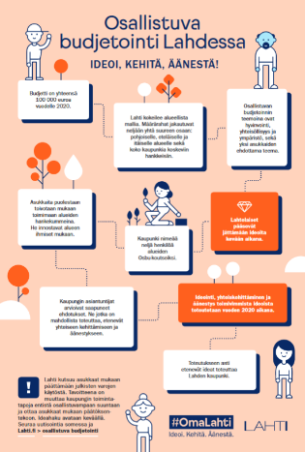

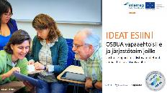

Lahti Pilot - Communications
To boost the PB pilot and awareness of the subject the City (supported by EmPaci) has used a multichannel approach:
Social media (Instagram, Facebook, Twitter)
Webpages
Local radios
Press releases to local press
Internal releases for city employees, local politicians and management
Ads in local newspapers
Posters and flyers distributed by Project Guardians to shops and other “hot spots” at areas
Intranet (for city employees and LAB employees and students)
Direct emailing (NGOs and other stakeholders)
Outdoor advertising in the city center
Live events and PB Team going to the areas in the city to promote in public and at different facilities (for elderly etc.) were planned but COVID-19 changed the plans
Source: Tia Mäkinen 2019/2020 & lahti.fi

Slide 10
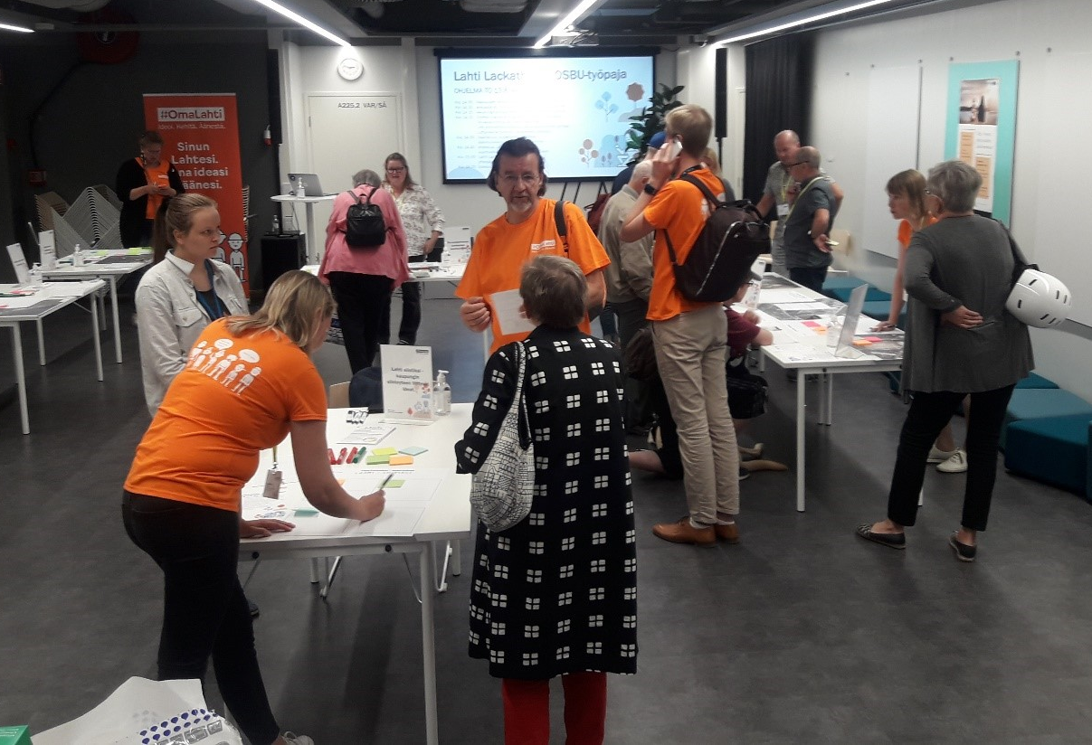
Co-Creation
A Lackathon Event
The City of Lahti and EmPaci arranged an open co-creation event in August
The aim was to bring citizens, city employees and other stakeholders such as NGOs together to work on some 14 ideas that were give in the Idea Creation Stage
Each idea/theme had their own service point where the city had provided pictures, maps etc. to showcase the ideas and help the co-creation along
Among the ideas were improvements for recreational areas, street art and a food bank -idea.
The co-created ideas moved on to the voting stage.

Slide 11
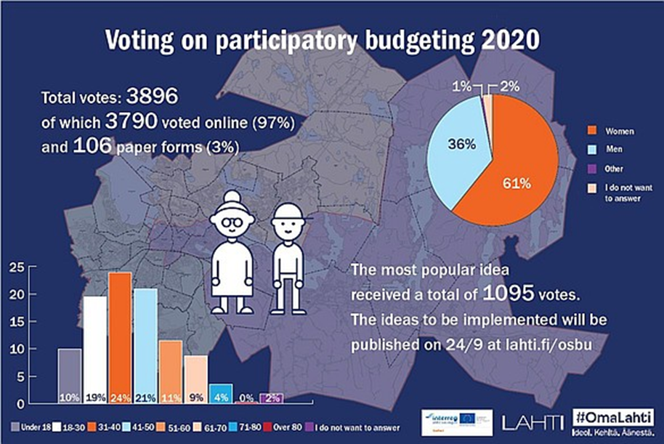
Results of the OmaLahti PB-pilot

Slide 12
The Results of the OmaLahti PB-pilot
To be implemented in 2021
The ideas to be implemented for the total of 100 000 €, 25 000 €/each area
Northern area:
Frisbee golf track to Ahtiala
Eastern area:
Livening up the market square in Lahti
Setting up guarded bike parking at the market square
Street art to the Lahti centre
Flowers to the Lahti centre
A food distribution point for the Nastola area
Southern area:
Developing the nature path at the Porvoo river region
Developing the Sopenkorpi kesanto area (an outdoor are with events)
Bringing a Wibit-track to the outdoor pool in Lahti
Entire city:
Setting up a cherry tree park (the most voted on idea in the pilot)

Slide 13
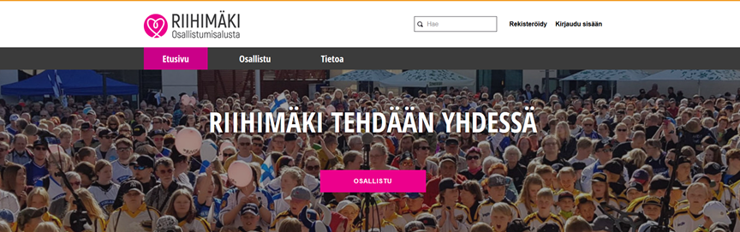

Pilot 2. Riihimäki
The aim of the PB is to inspire citizens to give ideas and vote on them thus making Riihimäki a better place to live.
Riihimäki has a fund of 1 Million EUR in place for PB, 50 000 € of which was spent in the first ever PB in 2019.

Slide 14
Example of Local PB Rules
Riihimäki
Ideas/proposals must:
Fall under city jurisdiction
Be in line with city strategy and values
Produce joy for a maximum number of citizens
Be in the public interest
Source: https://www.lahti.fi/paatoksenteko/osallistujavaikuta/osallistuva-budjetointi

Slide 15
2.Finnish Examples:
Riihimäki PB pilot, round 2, 2020-2021
Riihimäki PB-team= 1,5 people supported by communications and other divisions on a need-basis. An internal steering group.
Idea creation by inhabitants (Fall)
  A general theme of ideas bringing wellbeing to Riihimäki inhabitants. Everyone from Riihimäki can take part.
Pre-Check by City (Fall)
  24/45 ideas moved into this phase
  Those that have left ideas will be asked to participate in co-creation as well as implementation
Voting open to all inhabitants over 12 (Fall)
  Done using the platform
Implementation by the City (Winter/2021)
Specialty:
A Web-based platform in use for gathering ideas and voting on them: https://osallistu.riihimaki.fi/processes/osbu-2020/f/4/?locale=fi
Libraries also assist in participating
In order to move through to the pre-check phase, an idea needs to get 10 Likes on the platform

Slide 16
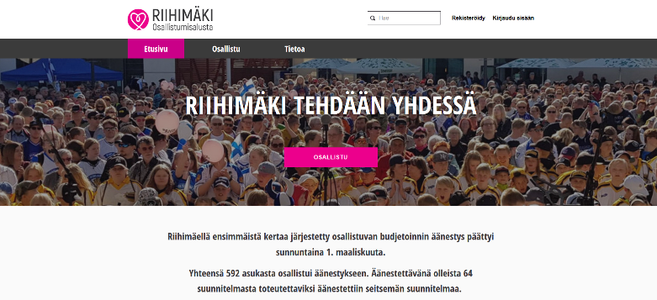
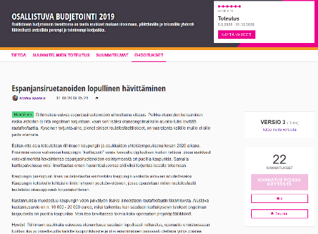
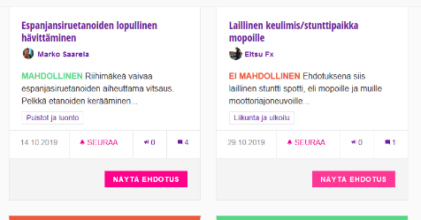
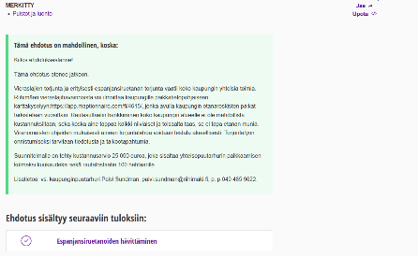
Tips from Finland
Decidim-based solutions - Riihimäki
An online platform was used in the first round and is used now.
Ease of use and good accessibility (libraries also used)
https://osallistu.riihimaki.fi/
Material from Riihimäkis’ Decidim-platform

Slide 17

www.empaci.eu
www.lab.fi/empaci
ANNUKKA HEINONEN, LAB-UNIVERSITY OF APPLIED SCIENCES
SEESAM TSOKKINEN, LAB-UNIVERSITY OF APPLIED SCIENCES
LOTTA-MARIA SINERVO, TAMPERE UNIVERSITY
KAISA KURKELA, TAMPERE UNIVERSITY
MERI PULKKINEN, TAMPERE UNIVERSITY
EmPaci

