Slide 1
2. PB Cycle
Steps toward PB in Municipali​ties
How to get started?
[Experiences from Finland]

Slide 2
2
Steps toward PB in Municipali​ties
CONTENT
2.1. Developing PB​
2.2. Planning implementation (method/model)​
2.3. Implementing (pilot)​
2.4. Evaluation​
2.5. Continuous development​
2.6. Resourcing​
Sources

Slide 3
3
2.1. DEVELOPING PB

Slide 4
4
Developing PB: What?

Slide 5
5
Examples of Ways Of Implementing PB
Theme or city division
Inhabitants take part in planning and decision-making regarding a set theme, funds or parts of funding for specific city division.
Area or neighborhood
Inhabitants from a specific area or neighborhood take part in a specific PB-run.
Project
Inhabitants take part in planning and decision-making of a one-time project.
Percentage of budget
A fixed, annual percentage of municipal or divisional budget allocated for PB.
Source: Ritva Pihlava 2017. Kuntaliitto: Osallistuva budjetointi kunnissa ja maakunnissa. P. 6-7
Available at: http://shop.kuntaliitto.fi/product_details.php?p=3356

Slide 6
6
PB Process in General
IDEAS
VOTE
€
This is my idea…
……………………………………….
Idea 1.
Idea 2.
Idea 3.
Idea creation
Inhabitans are asked to give out ideas on how to improve their municipality. The theme can be open or limited. An area or target group can also be given or selected.
Co-Creation and Pre check
Ideas are co-created by inhabitants and city experts on online platforms or events to turn the initial ideas into proposals. Some form of pre-check to make sure the proposals could be implemented usually occurs during this phase.
Voting
Voting can take place on an online platform, using an inquiry tool, in paper and pen –format or a combination depending on the resources available. There can be an age limit, area limit or similar.
Implementation
The vote settles the proposals that are then implemented.
Source: see e.g. Method, participatory budgeting. https://participedia.net/method/146

Slide 7
7
1. Developing PB: Why?
Global trends concerning citizen participation activities
Overall discussion about democarcy
Benchmarking between different countries
Digital era
Overall discussion concerning direct democracy
Question of social justice, equality and accessibility
Lower trust for reprentantive democracy and lower voting turnout in parlamentary and local elections -> need for new channels of participation to include also non-voters.
Need for local government to renew it's course of actions.
Regulation
Countries may have legislation that obligate local governments to develop methods of participation
Local governments may also take strategic decisions to obligate organisation to develop certain strucures of participation or overall development and change towards the culture of participation.

Slide 8
8
Developing PB: Why?
Advantages of PB from the viewpoint of government
Education
Possibility to learn from citizens and their preferences and important issues
Wider understanding about the current challanges and possibilities for interaction concerning these issues
Possibilities to inform citizens about government's acitities and budget-related issues
Wider understanding about allocation of public funds
Trust
Build trust and gain citizens' commitment to local community
Possibility to gain legitimacy for government's actions
Quality of processes
Possibility for better policy and implementation and better quality for services
Helps government to develop it's processes more open, transparent and participatory and practice for example methods of co-creation
Sources:
Pihlava, Ritva (2017) Osallistuva budjetointi kunnissa ja maakunnissa.Kuntaliitto. osallistuvabudjetointi_ebook.pdf
Irvin, R. A., & Stansbury, J. (2004). Citizen participation in decision making: is it worth the effort?. Public administration review, 64(1), 55-65.

Slide 9
9
Developing PB: Why?
Advantages of PB from the viewpoint of citizens
Education
Helps to understand the governement processes.
Wider understanding about the current challanges and possible to interact concerning these issues
Helps to understand the preconditions (concerning budget etc.) of government's actions
Active citizenship
Enables an access to government's processes
Produces an experience of active citizenship fot participants
Sources:
Pihlava, Ritva (2017) Osallistuva budjetointi kunnissa ja maakunnissa.Kuntaliitto.
Irvin, R. A., & Stansbury, J. (2004). Citizen participation in decision making: is it worth the effort?. Public administration review, 64(1), 55-65.

Slide 10
10
2.2. PLANNING IMPLEMENTATION (METHOD/MODEL)​

Slide 11
Choosing a Theme for PB
11
Examples of PB Themes:
No special theme: Citizens can freely propose ideas. However budget, legislation and municipality's authority may set limits to proposals.
Special theme or themes: There is special theme (s) for PB (e.g. environmental or cultural issues). Proposals have to fit into this theme. Budget, legislation and municipality's authority may set limits to proposals.
Prepared proposals: Municipality gives loose proposals from which citizens can choose.
Special target group(s): PB is indicated to issues that concern certain citizen groups (e.g. chidren, old people, disabled).
Special region/city district: PB is focused to certain city district.
The budget defines, which of these options (if any) is suitable for the municipality. If the budget or other resources are small, some framing is sensible. Or if the aim is to pay attentioon to special socio-economical issues or some hard-to-reach groups, it is sensible to frame the target group or for example the city district.
Choosing the theme carefully is important, because it influences on the amount of proposals and the voting turnout. One option is to discuss about the themes with the citizens before decide anything. The themes can be co-created.

Slide 12

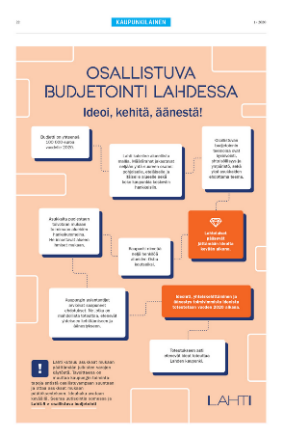
12
2.Finnish Examples:
Lahti PB Pilot 2020
Five steps of the #OmaLahti-process:
Idea creation by inhabitants (spring)
Four themes, three from City one from inhabitants
Pre-Check by City (summer)
Co-Creation by City and inhabitants (summer/fall)
Voting open to all inhabitants (fall)
Implementation by the City (fall--- 2021)
Specialty:
Project Guardians – volunteer inhabitants supporting the pilot externally in their areas
PB Coaches -chosen individuals from the City organization supporting the pilot internally within the city divisions
Pictures: The City of Lahti
Source: https://www.lahti.fi/paatoksenteko/osallistujavaikuta/osallistuva-budjetointi & Tia Mäkinen and Sanna Virta, PB Team at the City of Lahti

Slide 13
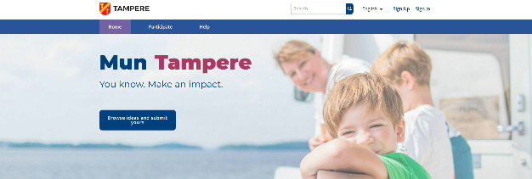
13
Finnish Examples:
Tampere PB pilot 2020
Steps of the ”Mun Tampere” -process:
Innovation by inhabitants (spring)
Preliminary inspection by City (summer)
Workshops by City and inhabitants (summer/fall)
Evaluation of costs (fall)
Voting open to all inhabitants (fall/winter)
Implementation by the City (winter--- 2021)
Specialty:
Only one target group and theme – well-being of children and youth
Source: https://mun.tampere.fi/pages/osbu-vaiheet?format=html&locale=en

Slide 14
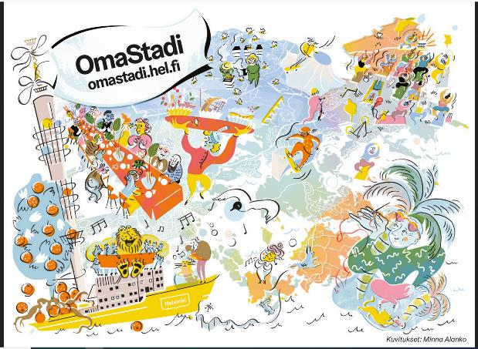
14
Finnish Examples: OmaStadi
Helsinki PB pilot 2019 – 2020
Five steps of the #OmaStadi-process:
Idea creation by inhabitants
A loose theme “Making the City more functional, cozier and fun”
Pre-Check and cost calculation by City to be placed on the open Decidim-PB platform
Co-Creation by City and inhabitants online and at special OmaStadi Raksa co-creation event
Voting open to all inhabitants over 12 years old, on the platform
Implementation by the City
Specialty:
“Stadiluotsit” – City Pilots – a group of city employees that work on different areas of Helsinki to support the inhabitants with PB as well as support the city organization. Also special Business Pilots.
2. Round is beginning in 2020 after an evaluation of the 1. process. Changes include the process being run every other year instead of the initial ideal of annually. Also more focus is put on the process reaching more and different groups of people (harder to reach groups etc.)
Picture: The City of Helsinki, Minna Alanko
Source: https://omastadi.hel.fi/processes/osbu-2019 & presentation by Jarkko Laaksonen City Pilot at OmaStadi (19.5.2020, TtT-online event)

Slide 15
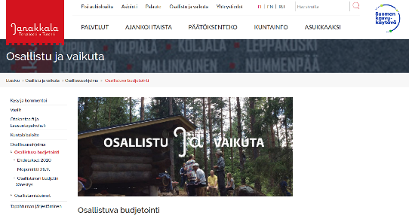
15
Finnish Example: Process in Janakkala
A Choice of Two possibilities. In this process the inhabitants got to choose from two different ways to implement their PB – A) a free theme project/projects to choose from or B) giving the available funds to stakeholders such as the area board to use
Idea creation by inhabitants
Inhabitants then submitted their ideas (almost 80 ideas)
Pre-Check and further shaping of the ideas by City to make sure they could be implemented and are in line with other municipal plans.
Voting where all inhabitants had one vote. An idea to have an artificial turf to a sporting arena won but as some money was left over, the runner up – a place for the youths’ motor sports was also supported with the funds.
Implementation by the City
Specialty:
Two votes – first to decide on the model and second to decide on the winner
Source: Janakkala. [Cited 17.6.2019] Available at: https://www.janakkala.fi/osallistu-ja-vaikuta/osallisuusohjelma/osallistuva-budjetointi/?fbclid=IwAR0vkwEVrdRuXVXdjw0-SMC3RJt1UHFYGNKupMrnJUtC1SBcE97IVxjoykU

Slide 16
16
List of possible PB Interaction Methods
Joint meetings, discussions
Inhabitant meeting or –panels
Hearings
Surveys (live and online)
Partnership tables
Workshops
World cafes
Open planning events
Joint preparation
Work groups
Consultations
Meetings between inhabitants and city officials and local politicians
Co-operation with local media
Co-operation with local NGOs
Source: Ritva Pihlava 2017. Kuntaliitto: Osallistuva budjetointi kunnissa ja maakunnissa. S. 14. Available at: http://shop.kuntaliitto.fi/product_details.php?p=3356

Slide 17
17
Example of Local PB Rules
OmaStadi, Helsinki
Ideas/proposals must:
Fall under city jurisdiction
Be implemented with the max. amount of funds allocated for set PB/Area/Theme. Employing permanent staff is not possible.
Be made in accordance with rules, regulations and the law
Fall in line with municipal decisions/planning
Ideas/proposals can not:
Exceed the allocated funds
Be targeted at for instance private property or violate current zoning
Be in breach of Finnish law or municipal decision
Be in breach of City values or strategy
Source: www.omastadi.hel.fi

Slide 18
18
Example of Local PB Rules
OmaLahti, Lahti
Ideas/proposals must:
Be made in accordance with rules, regulations and the law
Fall under city jurisdiction
Be in line with the give themes
Be implemented with the max. amount of funds allocated for set PB/Area/Theme. (Can also be considered as partial funding for a larger project)
Not have long-term financial impacts for the city (no permanent staff, large maintenance costs)
Be non-commercial
Be non-discriminatory and promote equality
Be possible to be implemented by the City in 2020 - 2021
Source: https://www.lahti.fi/paatoksenteko/osallistujavaikuta/osallistuva-budjetointi

Slide 19
19
Example of Local PB Rules
Mun Tampere - Tampere
Ideas/proposals must:
Be made in accordance with rules, regulations and the law
Fall under city jurisdiction
Be implemented with the max. amount of funds allocated for set PB
Be in line with the give theme
Be free and free of charge for all
Be time-limited and experimental
Source: https://mun.tampere.fi/pages/arviointi-lainmukaisuus

Slide 20
20
2. PB RESOURCES
Examples of Funding Models
Porto Alegre -model
Source: Based on Ahonen & Rask, 2019, P. 5-7. OSALLISTUVAN BUDJETOINNIN MALLIT JA TRENDIT SUOMESSA. Available at: http://shop.kuntaliitto.fi/product_details.php?p=3573

Slide 21
21
2. Common Characteristics of PB
There is not a single model or method for running a PB, so the implementations vary between local context and when PB is run
International flagship that a commonly benchmarked PBs include Paris, New York and Helsinki
Some common Characteristics include:
Financial resources at the heart of the process
An open process
Repetition of process
Public discussion on ideas and implementation
A variety of participatory & internactive methods used
Implementation for instance at city/regional level, projects around themes
Responsibility on how to monitor and evaluate implementation of proposals
Source: Pauliina Lehtonen, 2020

Slide 22
22
2. Examples of Co-Creation & Communication Methods
Unofficial discussions
Working groups, councils, advisory boards, co-operation groups
Theme discussions
Giving the chairmanship in an advisory board
Official consultations and hearings
Communication and discussion on webpages, a joint platform or social media
Communications through media
Workshops and dialogue events
Events
Pilots and experiments, RDI-projects (forming a picture of the situation)
Surveys and inquiries
Source: Katja Syvärinen, 18.2.2020, TtT-event presentation

Slide 23
23
2. Co-creation - Principles
Enquires equal participation. All stakeholders participate widely from the beginning, become heard and know the effects and results of the participation.
The different goals of participants are known. Common themes are sought, and different knowledge and views are brought together.
The process moves quickly from small experiments toward large goals
Skillful facilitation and carefully selected working methods are used
Openness, encouraging mood and the ability to handle different emotions is important
Source: Katja Syvärinen, 18.2.2020, TtT-event presentation, based on Aaltonen ym. 2016)

Slide 24
24
2. Co-Creation – Invitation Process:
Pay special attention to the invitation process as the foundation of successful co-creation is laid at that stage:
Who will take part? (Target group/groups)
Why should inhabitants take part? (incentive)
Is there a common understanding on who would be the “right kind of participant”?
How could we reach the less motivated to take part?
Do all inhabitants have the same kind of possibilities to take part and have their say?
Is the management (city, divisions, PB Team) committed?
Source: Katja Syvärinen, 18.2.2020, TtT-event presentation, based on Aaltonen ym. 2016)

Slide 25
25
2. Commercial Methods for Co-creation
IN ENGLISH
https://www.thisisservicedesigndoing.com/methods
https://www.strategyzer.com/canvas
Lari Karreinen –model in Freedcamp
IN FINNISH
https://agilemobile.fi/
https://innokyla.fi/fi/tyokalut
Lari Karreinen, mallipohja Freedcamp (also: http://www.karreinen.org/2013/11/suosikkikirjoja-osallistavista.html)

Slide 26
26
2.3. IMPLEMENTING / PILOT

Slide 27

27
Steps Towards Lahti Pilot 2020
It is the vision of The City Of Lahti to be a brave environmental city in 2030
Their values are: Openly, Responsibly, Together
Lahti also aims to make it possible for all inhabitants to take part in developing the community
In 2019, the City of Lahti worked on establishing a current state analysis of their work on participation and PB in co-operation with EmPaci
There were different types of activities such as a workshop for city employees from different divisions working on participation, benchmark visits to other Finnish municipalities. Also two surveys; internal survey for staff and other for inhabitants on participation.
Knowledge on PB, running a pilot in Lahti and EmPaci, was also spread at seminars for city employees, local politicians and other interested parties as well as Lahti Science Day and a Conference on Public administration and local government studies.
The Division of Participation and Wellbeing decided on continuing planning of a PB pilot in August 2019 (Part of the City Project Portfolio (Mayor/management review) and the final political decision on running the pilot came in February 2020.
Source: Tia Mäkinen 2019 & lahti.fi

Slide 28
28
Backround on Why to try PB in Lahti?
To follow statute of the law (Municipal Act in Finland)
To strengthen the well-being of inhabitants (citizen as an active actor, not a passive service-user)
To build more open, transparent and participatory culture in municipal organizations
To create new ideas
To build new connections to inhabitants
To strengthen the understanding of inhabitants on how and why municipal funds are spent
To find solutions to things the questions/themes of PB
To change the way projects are done in Lahti
To do something fun with inhabitants and stakeholders
To find new places for making savings together with inhabitants
Source: Presentation at seminar September 2019, Tia Mäkinen from Association of Finnish Municipalities and Karreinen, L.

Slide 29
29
About Lahti PB Models
During the process different models were contemplated and researched by the City
Each model has its own pros and cons that were discussed within the project group and the city organization at seminars, meetings and workshops. Inhabitants or NGOs’ at a larger scale didn’t take part in these discussions.
Lahti decided to run the pilot 2020 using the Regional project model as it gives substantial power to the inhabitants and brings the concept of PB closer to all areas of the city. This was important as the inhabitant survey conducted in 2019 with EmPaci showed that the inhabitants are eager to try this method but know little of it at the moment.
Source: Tia Mäkinen 2019/2020 & lahti.fi

Slide 30
30
About Lahti PB Models
Models that were contemplated during the process:
City district / Area boards (institutional organ, official status)
City district / Area council (institutional organ, official status)
PB – percentage of budget for entire city (platform needed)
PB-grant / Regional, limited project model (platform needed)
Project model / Joint funds (platform needed)
Cooperation groups / Advisory boards
Neighbourhood and village associations
Neighbourhood meetings / area panels
Partnership tables
For further development, these 5 were chosen in late 2019:
Ideas and voting by inhabitants -model
Regional project model (this one was chosen as the pilot for 2020)
Project grants
Area council model
Regional partnership tables
Source: Tia Mäkinen 2019/2020

Slide 31
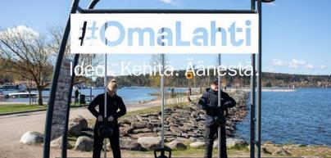
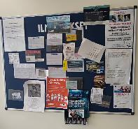
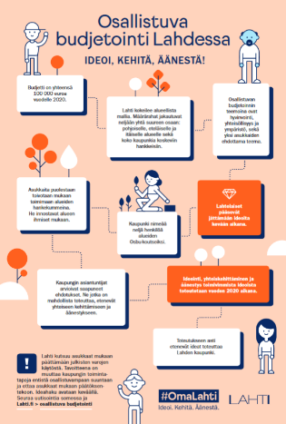

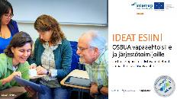

Lahti Pilot - Communications
31
To boost the PB pilot and awareness of the subject the City (supported by EmPaci) has used a multichannel approach:
Social media (Instagram, Facebook, Twitter)
Webpages
Local radios
Press releases to local press
Internal releases for city employees, local politicians and management
Ads in local newspapers
Posters and flyers distributed by Project Guardians to shops and other “hot spots” at areas
Intranet (for city employees and LAB employees and students)
Direct emailing (NGOs and other stakeholders)
Outdoor advertising in the city center
Live events and PB Team going to the areas in the city to promote in public and at different facilities (for elderly etc.) were planned but COVID-19 changed the plans
Source: Tia Mäkinen 2019/2020 & lahti.fi

Slide 32
32
Tips from Finland
What to consider when choosing a platform ?
What do we want to accomplish with PB in our municipality?
Is there a need for a specific platform or could other systems already in place be used for this as well?
How do we plan to use our platform: do we want to arrange voting, gather data, use visual tools such as maps and pictures?
How strong does the identification process need to be? Is it important to gather information about the people taking part (such as age, gender, resident of set community?), or restrict non-residents taking part? Should voting be restricted to only one vote per person?
What kind of resources do we have in our organization (IT, communications etc.)
How much modification is needed?
Source: talks with representatives from Finnish municipalities such as Lahti, Helsinki, Tampere, Tuusula about running a PB

Slide 33

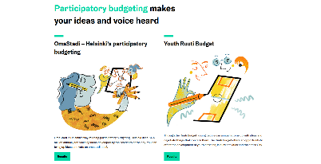


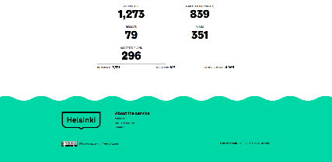
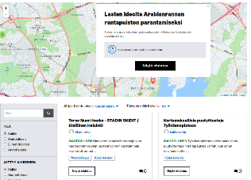
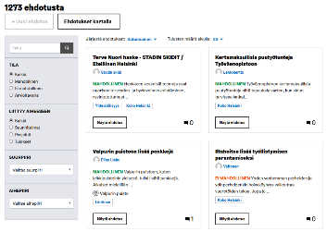
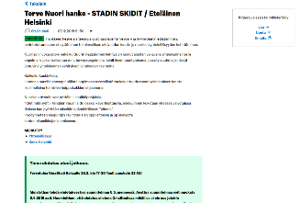
33
Tips from Finland
Decidim-based solutions - Helsinki
Helsinki uses a tailored platform that acts as a hub for all PB activity. It was used from idea creation to voting and at the moment the chosen ideas that are being implemented are on display. This makes it easy and convenient for inhabitants and other stakeholders to participate.
Source: www.omastadi.hel.fi

Slide 34
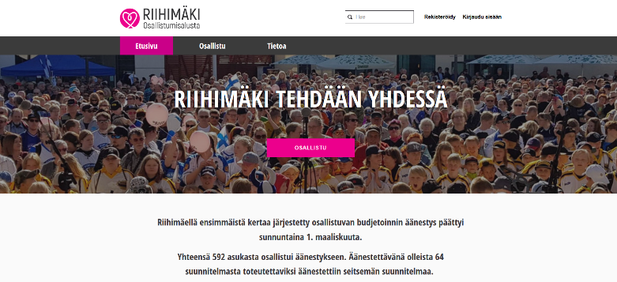
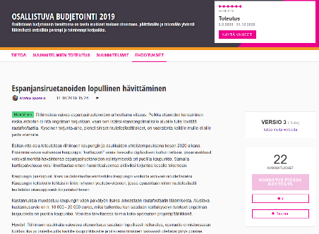
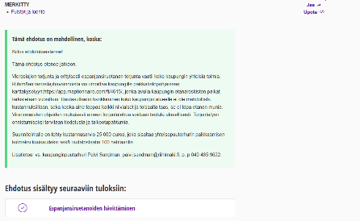
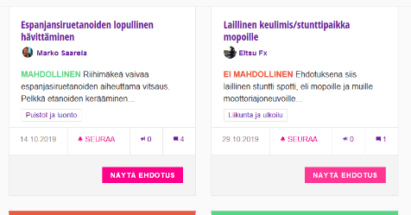
34
Tips from Finland
Decidim-based solutions - Riihimäki
https://osallistu.riihimaki.fi/
Material from Riihimäkis’ Decidim-platform

Slide 35
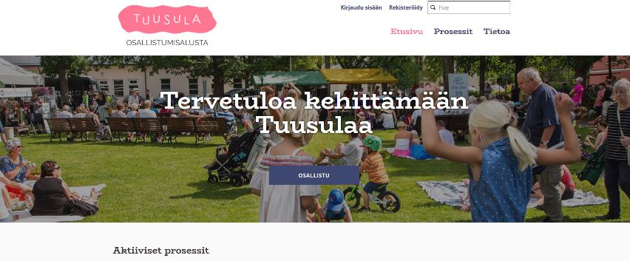
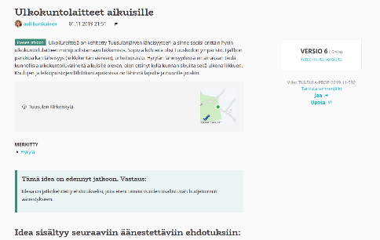
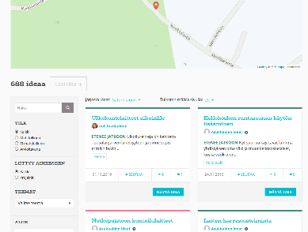
35
Tips from Finland
Decidim-based solutions - Tuusula
https://osallistu.tuusula.fi/
Material from Tuusulas’ Decidim-platform

Slide 36
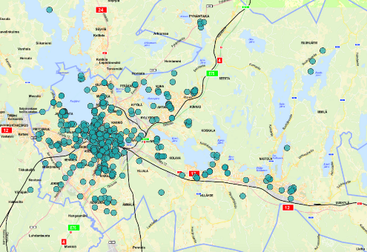
Tips from Finland
36
Making use of Existing Programs - Lahti
The City of Lahti decided to use existing programs for their 2020 PB pilot
As the process is ongoing there are just preliminary results of some of the following systems.
They plan on using different tools for different phases of the pilot:
For idea creation phase, Maptionaire https://maptionnaire.com/ which could have been tailored for PB use but Lahti used the existing version for budget reasons.
Maptionnaire worked well as an idea gathering tool, good feedback was received from inhabitants
Pros:
Easy and simple to use
City organization familiar with the tool
Cost-effective
Cons:
It is not possible to use this for voting
Not able to publish given ideas as they are submitted
(same ideas submitted multiple times)
Picture from Maptionaire – ideas gathered in the Lahti 2020 PB pilot
Source: Mäkinen, T & Lahti PB Team

Slide 37
Tips from Finland
37
Making use of Existing Programs - Lahti
For co-creation the ideas will be collected as PDF-documents placed on the city website
Readily available so a good alternative
Pros:
Easy for city organization
Cost-effective
Easy and familiar place and tool to access information from inhabitant point of view
Cons:
Not a platform so no two-way communication for all to see possible
Ideas less visually displayed
Voting will be done using Webropol or other survey tool the city already uses
A well know tool that is readily available
Pros:
Easy for city organization
Cost-effective
Cons:
Less possibility to limit or supervise voting
Source: Mäkinen, T & Lahti PB Team

Slide 38
38
What to Consider when Running a PB?
A Check List
Develop an understanding of what PB actually means in and for your municipality
Plan carefully (TIP from Helsinki: “remember that PB is an ongoing project that is constantly evaluated and developed so it can no be “finished” – just try it and improve along the way” K. Verkka, City of Helsinki)
Link PB to existing procedures and plans
Establish common rules
Make PB interesting for all
Think in the long term
Allocate enough resources on implementing PB
Be openminded
Communicate in an open and easy to understand way. Make communication ongoing.
Source: Ritva Pihlava 2017. Kuntaliitto: Osallistuva budjetointi kunnissa ja maakunnissa. P. 30-31
http://shop.kuntaliitto.fi/product_details.php?p=3356

Slide 39
39
3. What to Consider when Running a PB?
A Check List
PB method and sum (how is the sum divided)?
The scale and theme of PB
Resources; personnel, communications, technical solutions, spaces
Giving ideas/proposals; From whom, on which themes, how are they checked?
Presenting proposals; how, where, is there also co-creation?
Voting; Age limit, amount of votes, reaching different groups of inhabitants
Implementation of proposals; How, with whom, how was the money divided?
Tracking and evaluation; what happened afterwards, what was implemented?
Communication through out the project
Organizational context: structures, set of rules, strategies, attitudes within the org. towards participating people;
Source: Pauliina Lehtonen 2020

Slide 40
40
Tips from Finland
Case Tuusula
The municipality of Tuusula has just finished their third PB run and in the process tripled everything – ideas given as well as number of votes. They have found these things usefull:
Use people with similar backround/experience as icebreakers when contacting special needs groups and building trust
Use the expertice of personnel working with special needs groups
All material should be in an easy to read and comprehensible language/format
Remember different language versions (In Tuusula material in Finnish and English)
Use pictures to assist in building common understanding if there is a language barrier
In Tuusula, they found it challenging to reach families in peak years (with small children) so they went to family/childrens events, used storycrafting etc.
A PB suppliment in a local inhabitant magazine posted to all homes in the area worked well.
Members of the youth counsil were used as spokes persons in schools – this worked well
Attending a local winter carnewal that was held at the time of the voting was also successfull.
Source: talks with Katja Repo, Community Manager, Tuusula Municipality

Slide 41
41
2. Planning Implementation (Method/Model)​
When planning PB, one have to take into account certain issues, for example:
Organisational context: structures, set of rules, strategies, organizational culture (e.g. resistance to change, bureaucrazy vs. agility), organizational attitudes towards participating people, size of organization
Is there enough organisational and management support to conduct a proper process?
Resources: Is there enough resources (money, staff, know-how, it-solutions, communication, time,...) to conduct a proper process
How are the citizens, especially the silent groups reached?
What is done in other municipalities? (benchmarking)

Slide 42
42
2.4. EVALUATION

Slide 43
43
4. Evaluation
Example of Tools
Being able to show results and improvements made on a concrete level has a key role in convincing society of the positive nature of PB and justifying the joint municipal resources that are spent. This calls for easy access tools to enable municipalities to follow their progress.
One example is a first framework for a specific tool for evaluating participatory processes and methods “Yhteisluomisen tutka” that roughly translated to Co-Creation Radar. It has been developed by Finnish researchers Rask & Ertiö in 2019 and can be used to measure the effectiveness of methods used in PB as well as the actions taken (implementations).
Source: Loipponen & Heinonen, Smart Business Annual Review 2019 based on Rask & Ertiö 2019, Yhteisluomisen tutka – Malli osallisuustoiminnan kokonaisvaltaiseen arviointiin. Available at: https://www.theseus.fi/bitstream/handle/10024/263443/LAMK_2019_53.pdf?sequence=6

Slide 44
44
4. EVALUATION: Case OmaStadi, Helsinki
BiBu Mid-Term Review
Recommendations from University of Helsinki’s research team (researchers Mikko Rask, Titiana Ertiö, Pekka Tuominen, and Veronica Ahonen):
1. Transparency and dialogue in implementation can be developed through annual planning and improving the OmaStadi platform.
2. Measures for supporting the participation of marginalized groups need to be investigated to a larger extent.
3. The OmaStadi process should be streamlined so that as many ideas as possible advance to the voting stage.
Source: Direct quote from blog post on OmaStadi PBs’ Mid-Term evaluation by BiBu [Read 3.6.2020] Available at: https://www.democraticinnovations.com/2019/11/20/seven-recommendations-for-participatory-budgeting/

Slide 45
45
4. EVALUATION: Case OmaStadi, Helsinki
BiBu Mid-Term Review
4. The participate on ecosystem should be developed dynamically and interactively both inside the municipal organization as well as with other stakeholders.
5. The rules for idea submission should be communicated more clearly and targeting the budget for annually changing themes should be considered.
6. Evaluation needs to become a permanent component of the OmaStadi implementation and development.
7. The ideas and proposals submitted by residents should be used in diverse and innovative ways.
Source: Direct quote from blog post on OmaStadi PBs’ Mid-Term evaluation by BiBu [Read 3.6.2020] Available at: https://www.democraticinnovations.com/2019/11/20/seven-recommendations-for-participatory-budgeting/

Slide 46
46
4. Evaluation
Indicators for evaluating participation from wide perspective
Goals:
Democracy,
Sustainability
Topicality
Implementation:
Planning and prognosis
Quality and effectivity
Evaluation
Actors:
Representativity
Motivation
learning
empowerment
Output:
Skills and expertise
Decision-making and accountability
Institutional affects
Source: Rask, M. & Ertiö, T. (2019): Yhteisluomisen tutka: malli osallisuustoiminnan kokonaisvaltaiseen arviointiin. Helsingin yliopisto, kuluttajatutkimuskeskus

Slide 47
47
Tips from Finland
Case Lahti
Collecting information about the participants during the whole process, helps to gain information for example about which citizen groups participate. This data is a useful tool for further development of PB process to reach different citizen groups.
For example, in Lahti, following backround information was asked in the idea phase:
Postal code
Gender
Marital status
Age
Persons living in the same household
Amount of underaged children
Work status
Education level
Monthly income of the household

Slide 48
48
Tips from Finland
AO1:Upcoming report on Evaluation of citizen participation
June 2020 Finnish Association for Local and Regional Authorities (AO1) will publish their report (data to be added)

Slide 49
49
2.5. CONTINUOUS DEVELOPMENT

Slide 50
50
5. Continous development
Making PB a Process, not a Project
In an ideal case, PB should be a continuous process –a part of ordinary budget planning in municipalities
The beginning is often a project that then becomes a process after first pilots have been run and evaluations made
CASE: Helsinki 2.0

Slide 51
51
2.6. RESOURCING

Slide 52
52
6. Resourcing
Adequacy of PB resourcing
PB requires multiple types of resources from organization and administration and from citizens
For instance, recent Finnish experiences describes PB as resource intensive process
PB requires
Timeframe:​
Tampere model where planned carefully before the PB pilot starts
Lahti model more on the go​
Money:​
What is distributed​? Where the money comes from (Funds? Annual budget?)
What is needed to build and run the PB​? Staff costs, education & training costs, etc

Slide 53
53
6. Resourcing
Adequacy of PB resourcing
Process:​
Commitment and support from local council and management
Setting up project steering group
Voluntary work, allocated work hours, hiring staff
Internal resourcing: PB Coaches (volunteers, Lahti), Stadiluotsit (hiring, Helsinki)​
External resourcing:​ NGO-involvement, Schools​, voluntary citizens (Project Guardians, Lahti)
Organization:
Organizational culture – willingness to open, resistance to change

Slide 54


54
6. Resourcing
Adequacy of PB resources - risks
”In our City, everyone has the opportunity to participate, influence, meet other people and pursue self-realisation. The City is a platform for active engagement and collaboration by local residents and communities.”
Participation is the strategy document, but is it in the organization?
”City’s participation programme 2018-2020”
Is the participation in the action? Responsible project workers or shared participatory culture
”We have plenty of staff”
Participation and engaggement are unrealistic aims without the means to achieve them
”participation.co-ordinator@city.fi”
Resources for participation are inadeaqute

Slide 55
55
2.6. SOURCES

Slide 56
56
Sources
Other interesting sources used:
Irvin, R. A., & Stansbury, J. (2004). Citizen participation in decision making: is it worth the effort?. Public administration review, 64(1), 55-65.​
Pihlava, Ritva 2017. Kuntaliitto: Osallistuva budjetointi kunnissa ja maakunnissa. ​
http://shop.kuntaliitto.fi/product_details.php?p=3356​
Ahonen & Rask, 2019, P. 5-7. OSALLISTUVAN BUDJETOINNIN MALLIT JA TRENDIT SUOMESSA. Available at: http://shop.kuntaliitto.fi/product_details.php?p=3573 ​
Pauliina Lehtonen, 2020​. Presentation available at Freedcamp
Katja Syvärinen, 18.2.2020, TtT-event presentation​
Katja Syvärinen, 18.2.2020, TtT-event presentation, based on Aaltonen ym. 2016​
Democratic Innovations. Direct quote from blog post on OmaStadi PBs’ Mid-Term evaluation by BiBu [Read 3.6.2020] Available at: https://www.democraticinnovations.com/2019/11/20/seven-recommendations-for-participatory-budgeting/​
Ertiö & Rask, 2019. Yhteisluomisen tutka​
Loipponen & Heinonen, Smart Business Annual Review 2019 based on Rask & Ertiö 2019, Yhteisluomisen tutka – Malli osallisuustoiminnan kokonaisvaltaiseen arviointiin. Available at: https://www.theseus.fi/bitstream/handle/10024/263443/LAMK_2019_53.pdf?sequence=6
Method, participatory budgeting. https://participedia.net/method/146
LISÄÄ KUNTALIITON UUSI​ (New publication coming..)
Helsinki, OmaStadi:
OmaStadi www.omastadi.hel.fi​
OmaStadi https://omastadi.hel.fi/processes/osbu-2019​
Jarkko Laaksonen City Pilot at OmaStadi (presentation 19.5.2020, TtT-online event)​
Verkka, Kirsi. Development Manager, City of Helsinki, OmaStadi​ (talks at benchmarking event 2019)
​
​Lahti, OmaLahti:
https://www.lahti.fi/paatoksenteko/osallistujavaikuta/osallistuva-budjetointi
Tia Mäkinen and Sanna Virta, PB Team at the City of Lahti​
www.lahti.fi​
Tia Mäkinen, presentation at seminar September 2019, based on Association of Finnish Municipalities and Karreinen, L. ​
Tampere, Mun Tampere:
Tampere 2020. https://mun.tampere.fi/pages/osbu-vaiheet?format=html&locale=en​
Tampere. https://mun.tampere.fi/pages/arviointi-lainmukaisuus​
​
​Other municipalities:
Janakkala. [Cited 17.6.2019] Available at: https://www.janakkala.fi/osallistu-ja-vaikuta/osallisuusohjelma/osallistuva-budjetointi/?fbclid=IwAR0vkwEVrdRuXVXdjw0-SMC3RJt1UHFYGNKupMrnJUtC1SBcE97IVxjoykU​
Talks with representatives from Finnish municipalities such as Lahti, Helsinki, Tampere, Tuusula about running a PB​
https://osallistu.riihimaki.fi/​
https://osallistu.tuusula.fi/​
Katja Repo, Community Manager, Tuusula​. Talks and presentation (TtT-program)
Links:
https://www.thisisservicedesigndoing.com/methods
https://www.strategyzer.com/canvas
Lari Karreinen –model in Freedcamp
https://agilemobile.fi/
https://innokyla.fi/fi/tyokalut
Lari Karreinen, mallipohja Freedcamp (also: http://www.karreinen.org/2013/11/suosikkikirjoja-osallistavista.html)
​

