Slide 1

PARTICIPATORY BUDGETING
AS CIVIC ENGAGMENT TOOL

Slide 2

2
Participatory budgeting (PB):
PB is a democratic process in which community members decide how to spend part of a public budget.
PB directly involves local people in making decisions on the priorities and spending for a defined public budget. This means engaging residents and community groups representatives of all parts of the community to discuss and vote on them, as well as giving local people a role in the examination and monitoring of the process.
Notes:
2

Slide 3
3
Participatory budgeting (PB):
Civic engagement is a wide range of activities aimed at purposeful and meaningful interaction between the municipality and the citizens to make the municipal decision-making process and its results better.
Notes:
3

Slide 4
4
Main aims and objectives of a PB:
Gaining insight into what the population prioritises, and how different preferences are weighed against each other.
Distributing city budget according to what citizens have decided (especially for decisive types of PB).
Giving citizens the opportunity to interact with each other. Creating debate between people from different backgrounds and with different preferences or needs can promote empathy for ‘the other’ within the same community.
Building awareness and support. When the voice of citizens is taken into account, they will find more legitimacy in the chosen policies.
Giving citizens more insight in how budgeting decisions are taken. Through a PB, citizens learn how to make choices with finite city budgets.
Notes:
4

Slide 5
5
Benefits for citizens:
Dialogue between citizens and authorities makes both sides more democracy-minded.
Involving the public in planning the budget enhances their role as active, critical, demanding and responsible members of society.
Citizens monitor how the decisions taken jointly are implemented. Making the administration accountable can contribute to modernizing it.
Public participation leads to budget priorities being revised – which can result in an improved quality of life in a relatively short time.
Participatory budgeting can contribute to social restructuring and to gains in social justice.
Notes:
5

Slide 6
6
Benefits for the local administration:
With a more transparent budget, money is employed more efficiently, and administrators reap more public recognition for their work
Citizens support the budget decisions that they have been involved in taking.
Democratic culture and social cohesion are both enhanced.
When public funds are in short supply, public participation can lead to more general acceptance of the need for austerity measures.
Cooperation between citizens, politicians and administrators can help to create an atmosphere of trust.
Notes:
6

Slide 7
7
Types of Participatory budgeting (PB) I:
Various types of PB slightly differ from each other
Decisive or Advisory
If the outcome of the PB is fixed and the city commits to acting accordingly, the PB has a decisive character. If results are merely taken into account and viewed as suggestions in the allocation or draft of a budget, the PB has an advisory character.
Themes or Ideas
In some cases, a PB is held at the level of themes or policy domains. In other cases, the focus lies on concrete ideas or projects. And in other cases there’s a hybrid process.
(2018-2019) CitizenLab: The Beginner’s Guide to Participatory Budgeting)
Notes:
7

Slide 8
8
Types of participatory budgeting (PB) II:
In group or individually
Ideas or themes can be discussed in small groups before a vote takes place. Online trajectories are more suitable for individual participation, where citizens express their personal preferences.
Ideation or fixed framework
In many cases, you’ll already have a set of ideas or themes that your citizens can vote or comment on. In some cases, however, cities allow their citizens to submit their own ideas.
Local or regional
What’s the designated area for the participatory budget?
Does the project have an impact on the entire territory of the city or municipality, or does it focus on a particular neighbourhood? This also impacts who’s invited to participate in the PB.
(2018-2019) CitizenLab: The Beginner’s Guide to Participatory Budgeting)
Notes:
8

Slide 9

What needs to be in place for PB to work?
A dedicated source of public funding.
An agreed upon process and schedule.
A staff to mediate the process.
Community volunteers to facilitate the process.
Outreach to the neighborhood to get people to attend.

Slide 10
Participatory budget
implementation process
Announcement of an idea
Social networks
The media
Meetings live
Residents present their ideas
Electronically
In writing
Assess whether the ideas are suitable for implementation
A working group formed by the municipality
Location, legal, technical aspects are assessed
The realistic ideas to be implemented are presented to the residents
Social networks
The media
Meetings live
Residents vote for the idea they like best
The municipality implements the idea chosen by the residents
Collaboration with the idea provider
Electronically
In writing

Slide 11
Traditional budget and participatory budget models
TRADITIONAL BUGET
PARTICIPATORY BUDGET
Elected politicians
Civil servants
Elected politicians
Civil servants
CITIZENS
CITIZENS
CITIZENS
CITIZENS
CITIZENS
CITIZENS

Slide 12
PB MODELS
Participatory budgeting (PB)
Municipal
PB
Regional
PB
PB in Schools
Part of the municipal budget in a certain area
Large-scale projects using several municipalities
PB in Schools

Slide 13





PB allows to participate in the allocation of public finances for citizens, but
five basic criteria must be complied with:
It analyzes how a limited budget needs to be targeted
Residents of the entire city or district are included
There must be a constantly repetitive process
Meetings / forums should be held with residents
Accountability for performance

Slide 14
Rules are important and necessary for PB:
The definite political decision-makers of the mayor and heads of administration
The interest for civil society organizations and citizens in general
The rules of the "game" are clearly and generally defined
The competence of residents and municipal officials is expanded in order to acquaint them with the problems of society
Wide dissemination of information by all possible means of communication

Slide 15
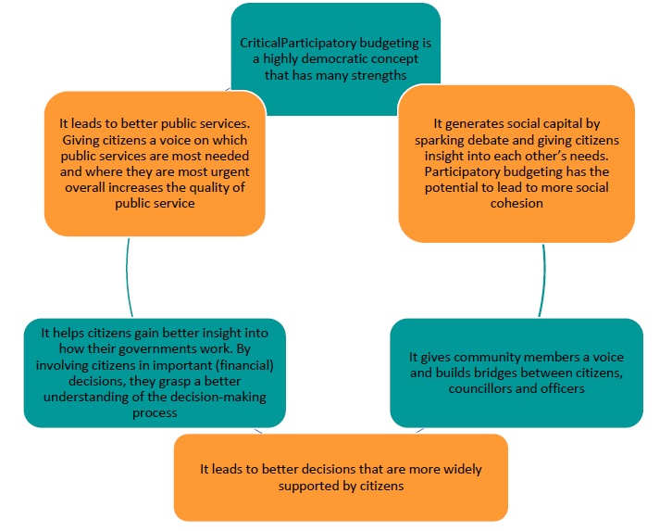
PB is a highly democratic concept that has many strengths
CriticalParticipatory budgeting is a highly democratic concpt that has many strengths
It leads to better public services. Giving citizens a voice on which public services are most needed and where they are most urgent overall increases the quality of public service
It generates social capital by sparking debate and giving citizens insight into each other’s needs. Participatory budgeting has the potential to lead to more social cohesion
It helps citizens gain better insight into how their governments work. By involving citizens in important (financial) decisions, they grasp a better understanding of the decision-making process
It gives community members a voice and builds bridges between citizens, councillors and officers
It leads to better decisions that are more widely supported by citizens

Slide 16
WEAKNESSES OF PB:
Interaction with the government increases the risk of community movement
Financial constraints and resources are limited, so the application of a participatory budget is limited
Communities stops to participating when their needs will be fulfill
Very poor young people and people from lower social backgrounds are under-represented
Participants is disappoint of the slow pace of public works
Fragmented decisions and short-term needs can to damage for urban planning and long-term projects
Manipulation of budget resources

